Slide 1
Switch - Status Meeting #2
Members: Xin Zhao, Yinuo Huang, Jin Feng Lin, Yueming Tang, David Huang

Slide 2
Overview
User stories
Personas
Wireframe
Current Progress
New Issues
Next Step...

Slide 3
User Stories
as a beginner, I want to have a starting tutorial that will guide me through the whole process of the game, so that I can have a better understanding on how to play this game
as a beginner, I want to the game to have only players with same levels to play, so that I won't be lose so badly to the experts
as an expert, I want to have weekly competition, so that I can feel challenged and motivated
as an expert, I want to have leader board, so that I can feel feel challenged and motivated
as an expert, I want to have different ranks and levels, so that I can feel challenged and motivated
as an ordinary user, I want to have different themes for the appearance of the game's interface, so that I can be kept fresh when playing game
as an ordinary user, I want to be able to gain coins to buy items that can help me in the game, so that I can play the game easier (because I don't want to play for VIP)
as a rich user, I want to be able to have VIP exclusive privileges, so that I can play the game easier
as an admin, I want to sell VIP exclusive privileges, so that I can gain profits
as an admin, I want to have the privilege to check players' profiles, so that I can resolve emergency events

Slide 4
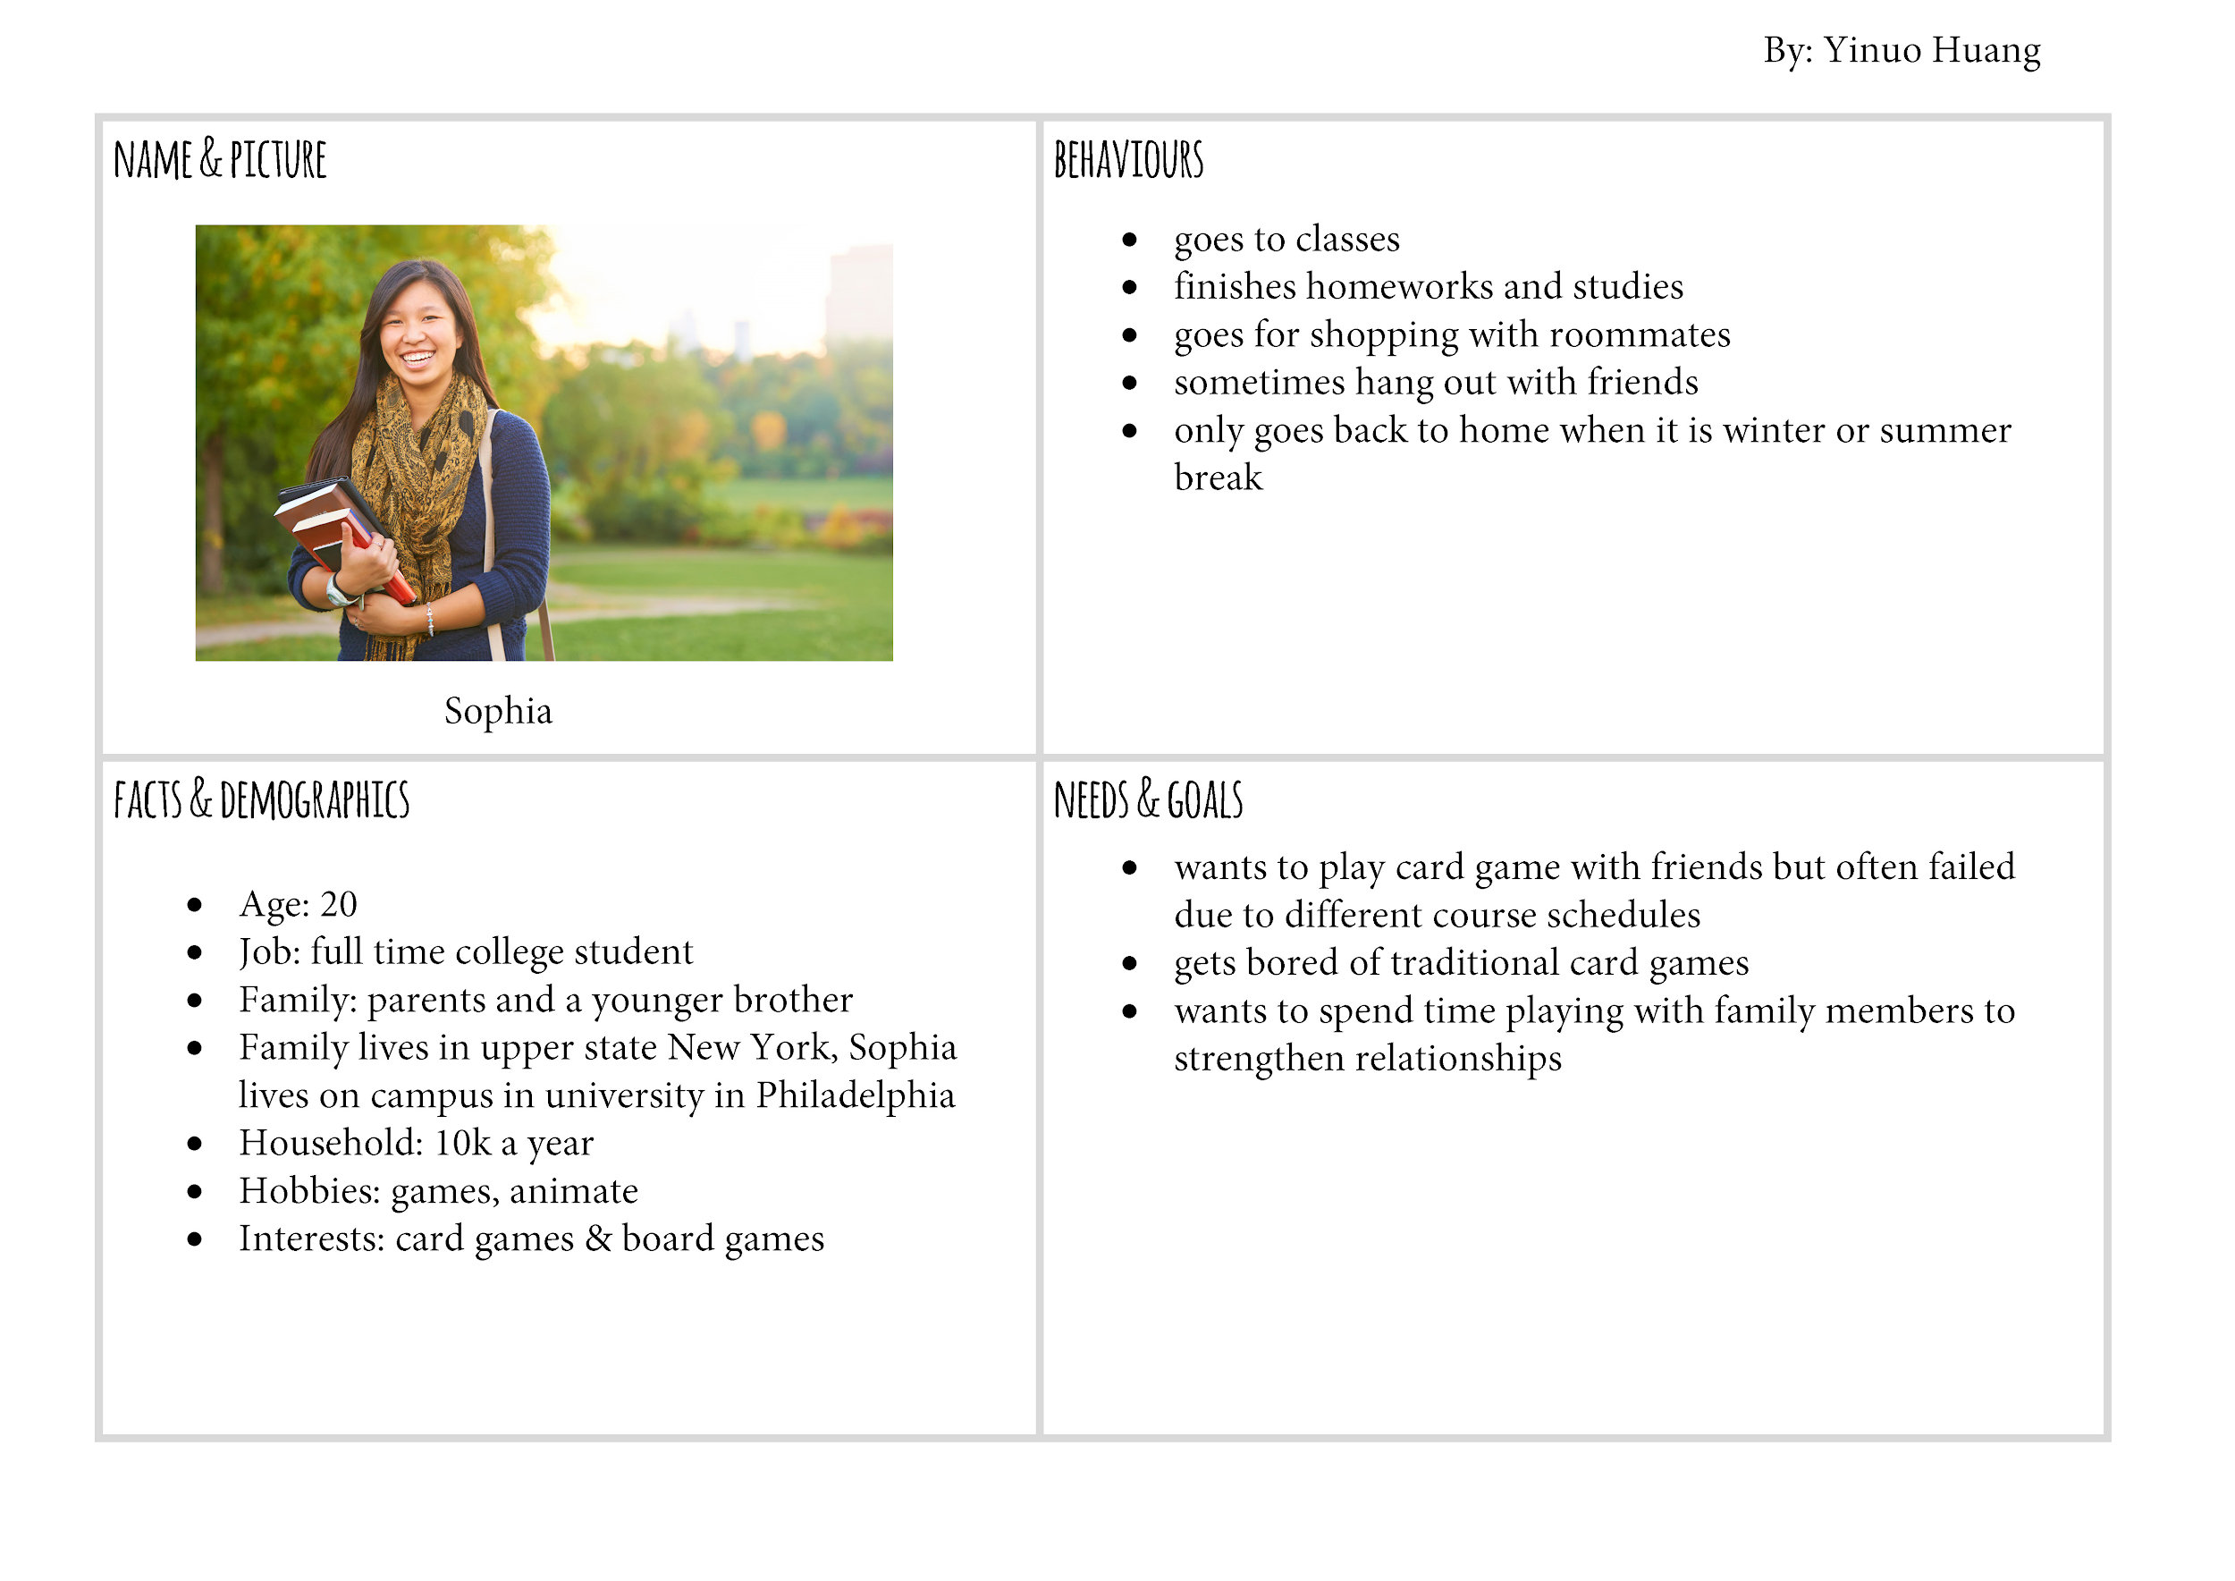
Personas

Slide 5
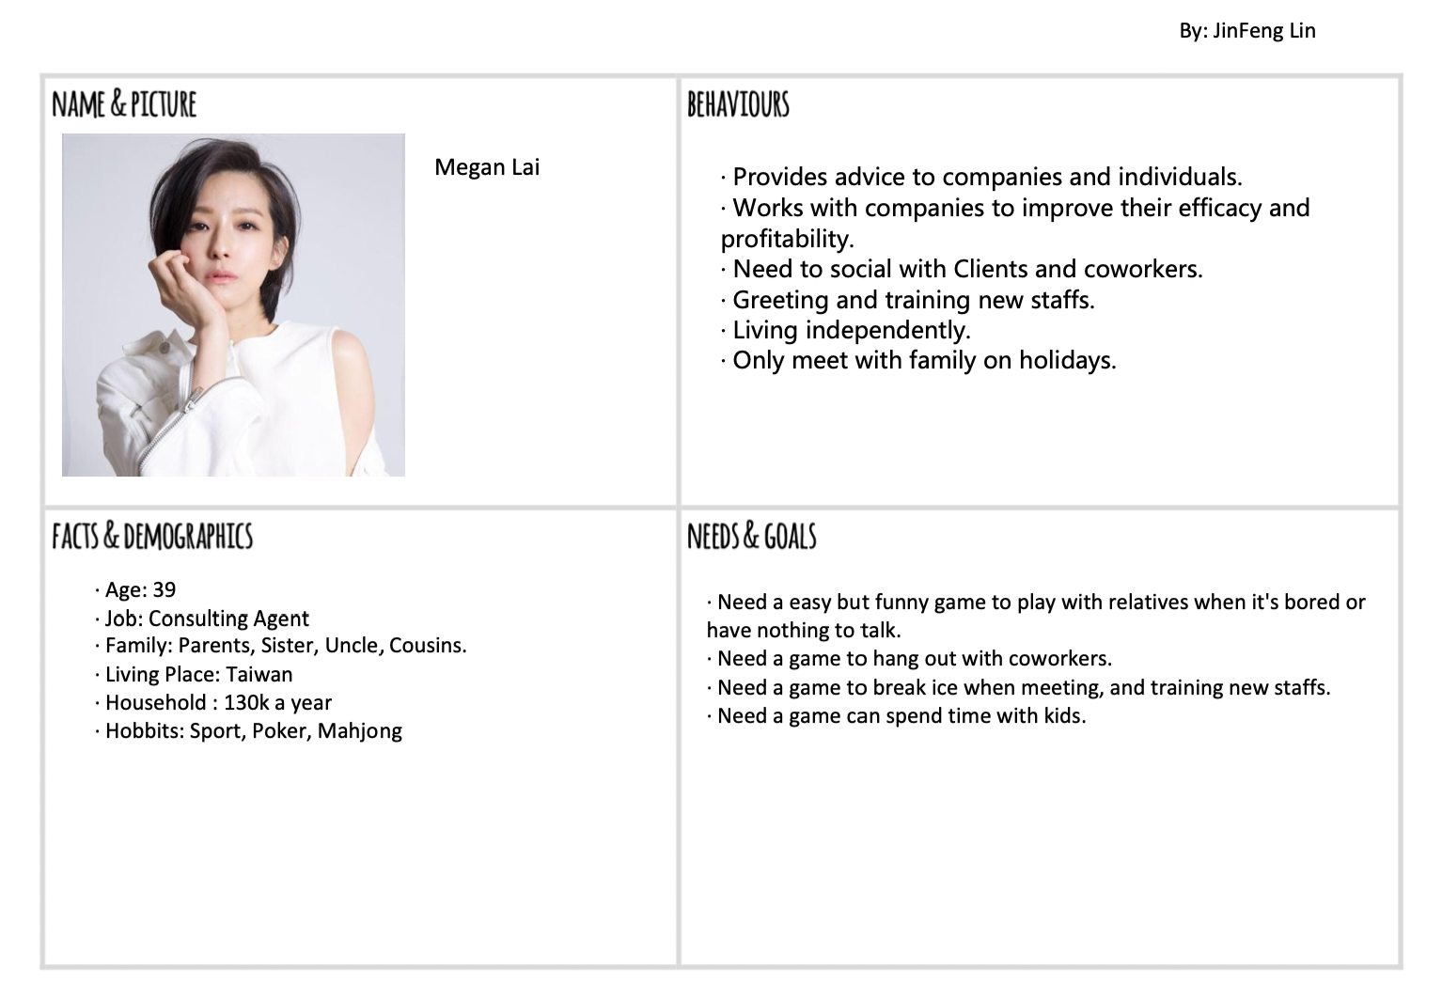
Personas

Slide 6
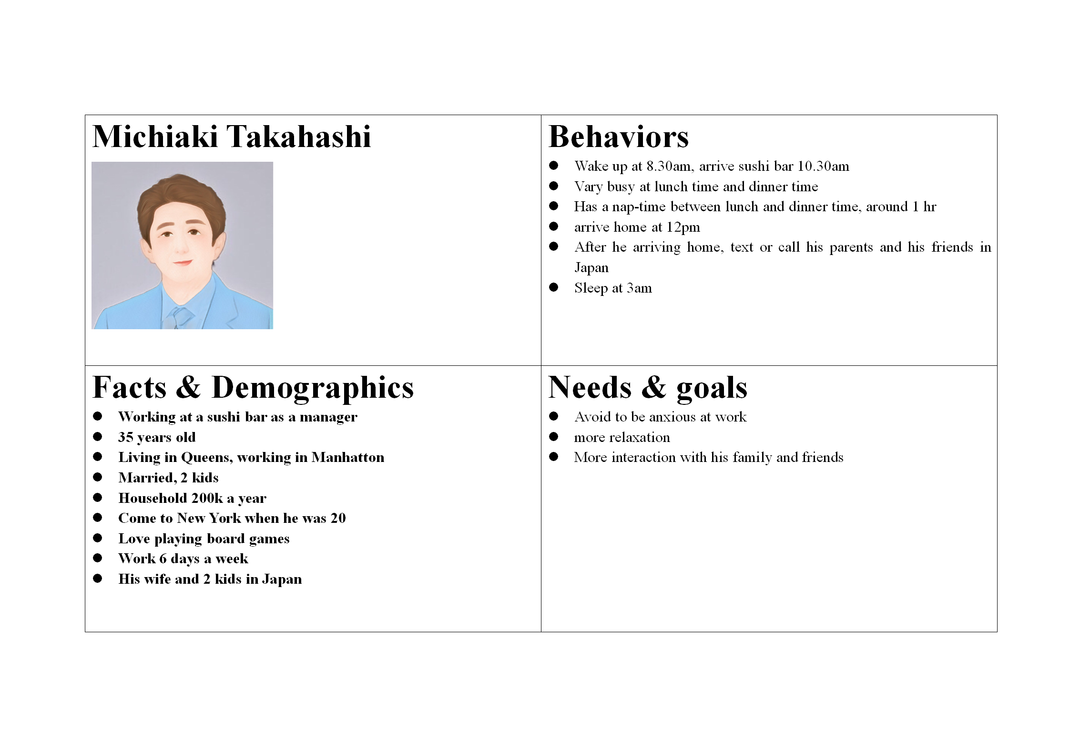
Personas
By: David Huang

Slide 7
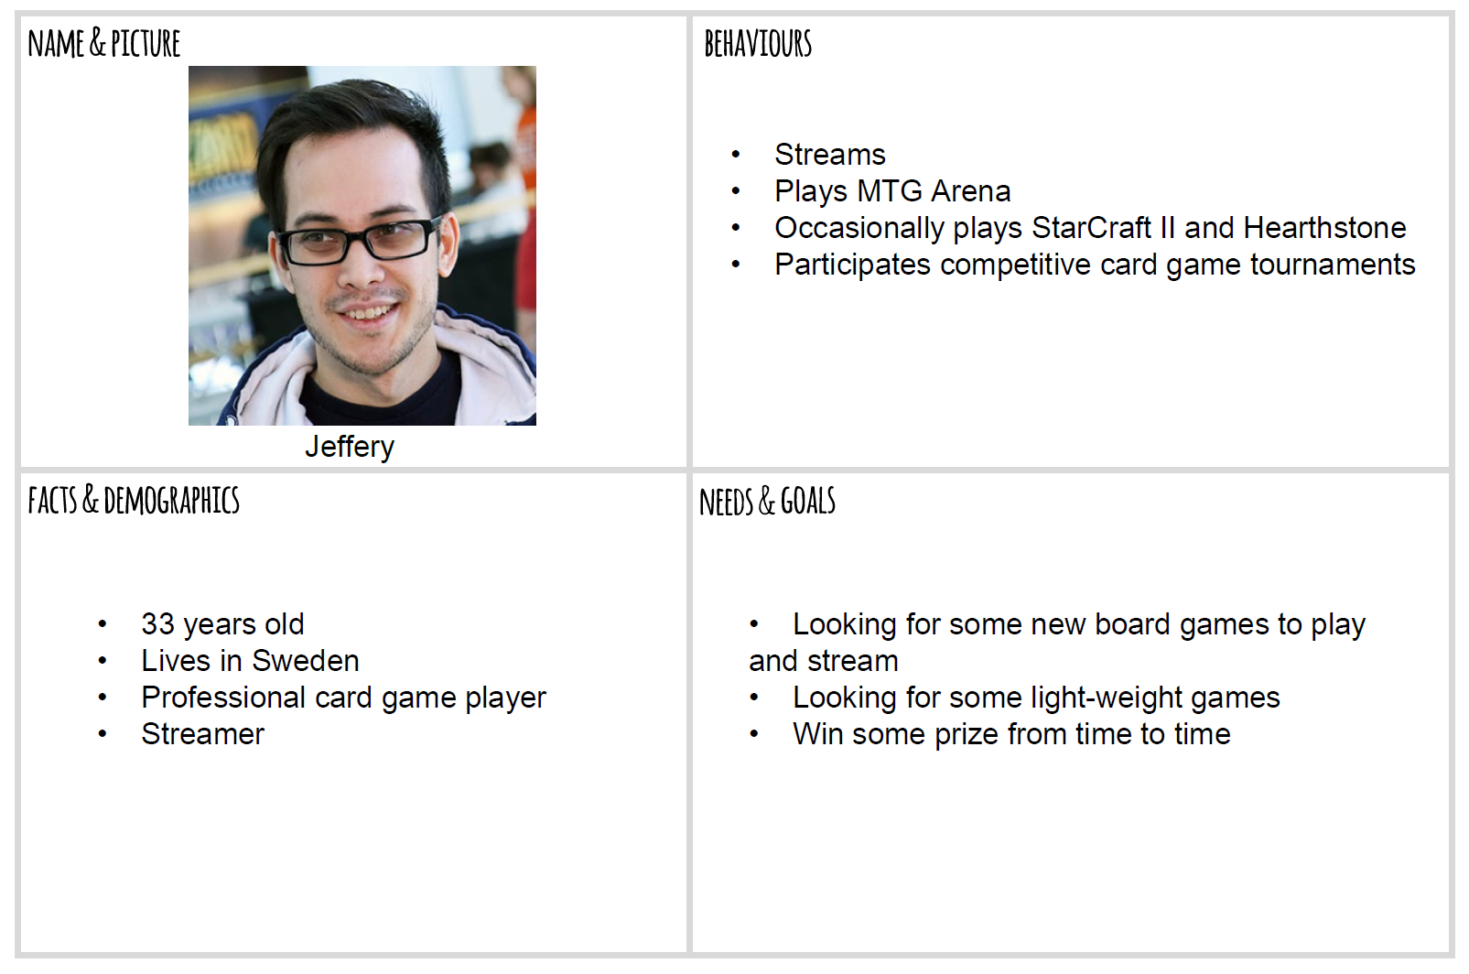
Personas

Slide 8
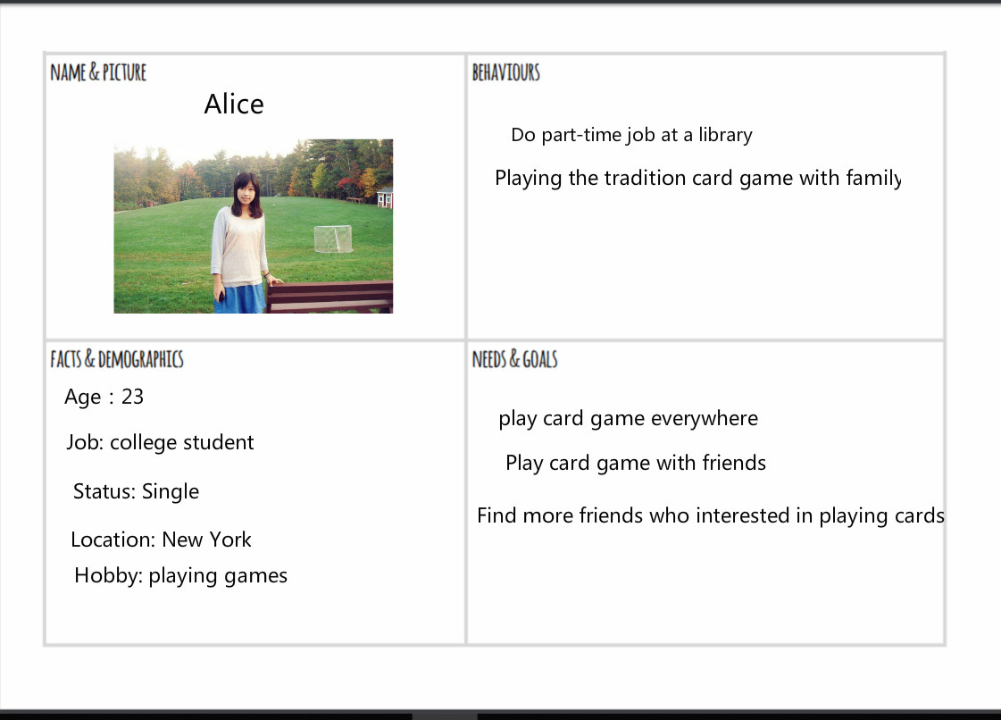
Personas

Slide 9
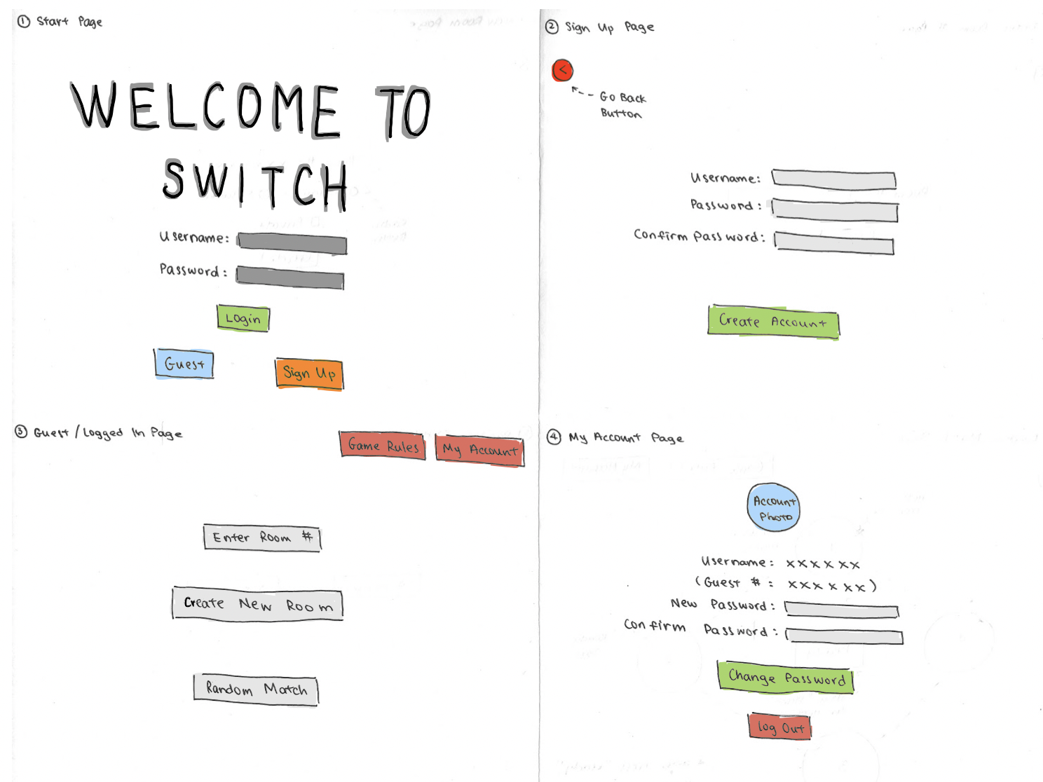
Wireframe 1

Slide 10
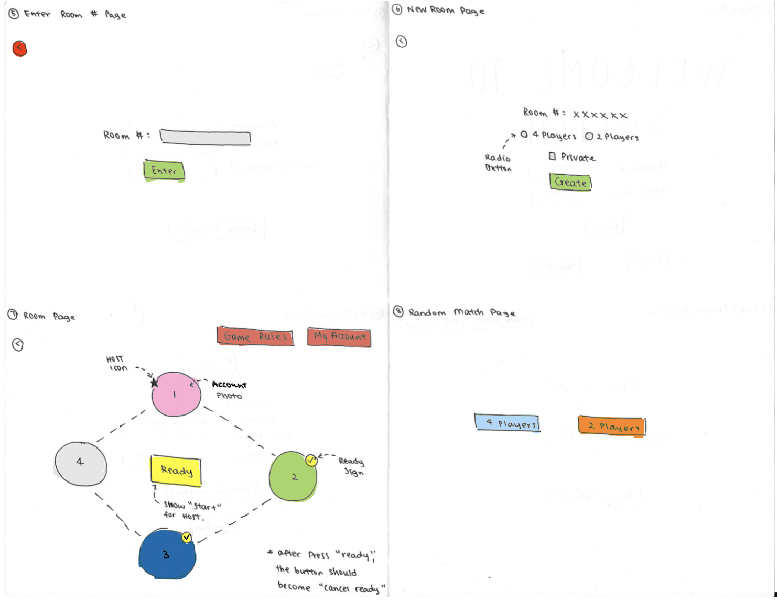
Wireframe 2

Slide 11
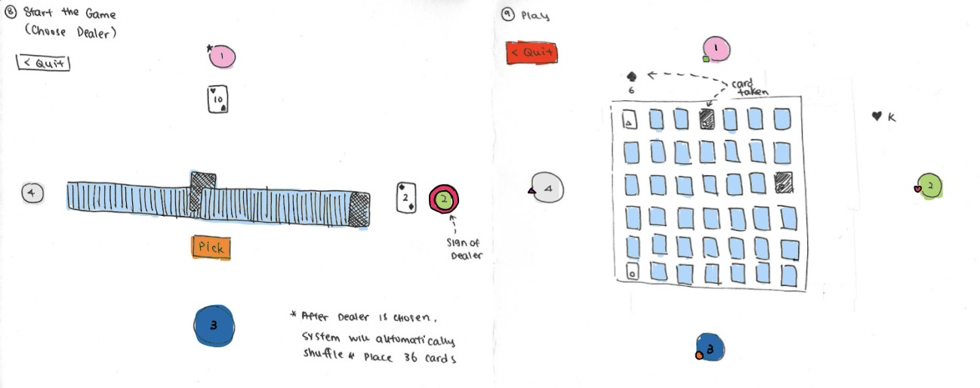
Wireframe 3

Slide 12
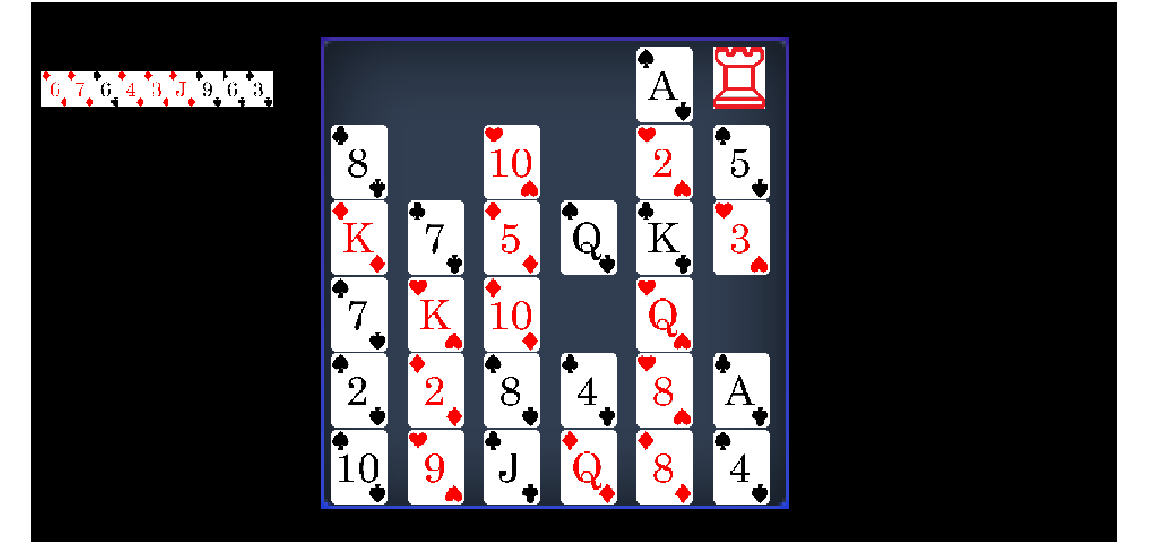
Game board

Slide 13
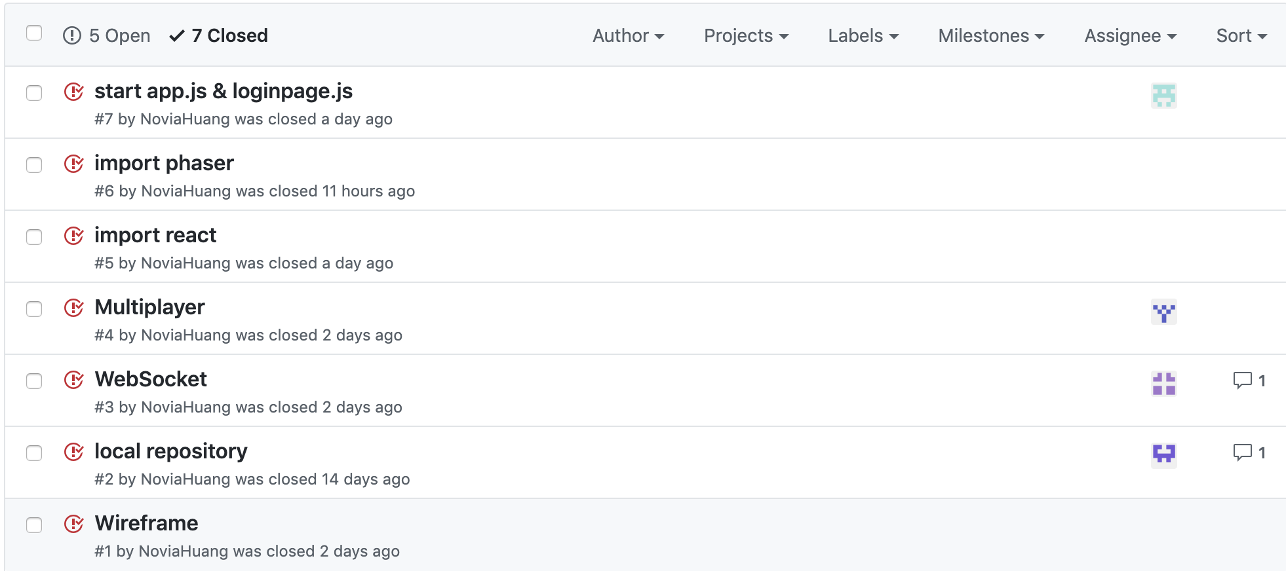
Current Progress

Slide 14
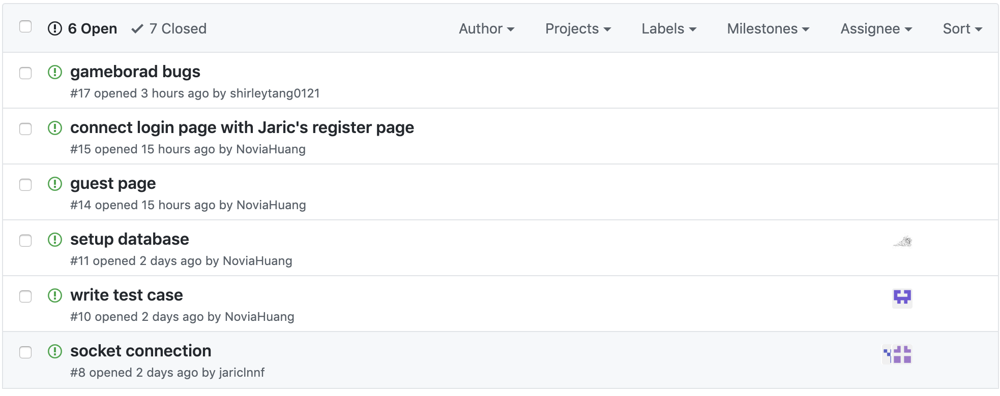
New Issues

Slide 15
Next Step...
Design proper data structure for player class
Integrate database to frontend
Try to use AWS Cognito for authentication
Set up socket for in-game chat
Keep working on building up the game interface

